Slide 1
Arrays and Vectors
Chapter 8

Slide 2
Arrays
C++ arrays, for the most part, are just like C-style arrays.
Allow you to store and work with multiple values of the same data type
Declared the same
Access elements the same
Store and display data the same

Slide 3
Arrays
C++ does not perform bounds checking
This means C++ does not check to see if an array subscript is in range
An invalid array subscript can cause a program to overwrite other memory
Example:
const int ISIZE = 3;
int num[ISIZE];
num[4] = 25;
num
25
[0] [1] [2]

Slide 4
Vector
Advantages over arrays
Do not have to declare the number of elements that the vector will have
If you add a value to a vector that is already full, the vector will automatically increase its size to accommodate the new value
Vectors can report the number of elements they contain, pointers can not

Slide 5
Vector
#include <vector>
How to create a vector
vector<int> numbers; //defines a vector of int
vector<int> numbers(10); //defines a vector of 10 ints
vector<int> numbers(10,2);//defines a vector of 10 ints and initializes them to the value of 2.
Vector<int> set2(set1);//the vector set2 will have the same number of elements and hold the same set of values as set1
important

Slide 6
Vectors - push_back and resize
A vector can grow in size as needed. Arrays can not
In order to add an element to a vector when the vector is full OR had no initial defined size you will need to use a function called push_back
You can also change the size of a vector by using a function provided resize(N)
Ex. vector<int> test;
test.push_back(75); //This adds 75 to the end of the vector
Ex. vector<int> scores(15);
scores.resize(25); adds 10 to the size of the vector.
prog8_23.cpp

Slide 7
Determine size of a vector
Use size member function to determine number of elements currently in a vector
Ex. howbig = scores.size();

Slide 8
Removing an Element from a vector
Use pop_back member function to remove last element from a vector
Ex. scores.pop_back();//Does NOT return a value only removes the last element
To remove all contents of a vector, use the function clear() – leaves the size of the vector to be 0
scores.clear();
To determine if vector is empty, use the function empty()
while (!scores.empty()) ...
prog8_25.cpp
prog8_27.cpp
resize.cpp vectorPractice.cpp

Slide 9
Vector of Objects
We can also have a vector of objects.
Let’s think about a Birthday class
vector<Birthday> bDays(2);
I can give these a value by calling the constructor;
vector<Birthday>bDays(2, (Birthday(10,10,1990), Birthday(10,7,1963)));
You can also pass a contructor to a call to push_back
bDays.push_back(Birthday(3,3,2017));

Slide 10
Array of Objects
Just as you can have an array of int’s you can have an array of objects.
class Square
{ private:
int side;
public:
Square(int s = 1)
{ side = s; }
int getSide()
{ return side; }
};
Square shapes[10]; // Create array of 10
// Square objects

Slide 11
Arrays of Objects
Like an array of structures, use an array subscript to access a specific object in the array
Then use dot operator to access member methods of that object
for (i = 0; i < 10; i++)
cout << shapes[i].getSide() << endl;

Slide 12
Initializing Arrays of Objects
We can use default constructor to initialize the array of objects.
We can use an initialization list – only works if there is only one data member in the class
Square shapes[5] = {1,2,3,4,5};
Default constructor is used for the remaining objects if initialization list is too short - only works if there is only one data member in the class
Square boxes[5] = {1,2,3};

Slide 13
Initializing Arrays of Objects
If an object is initialized with a constructor that takes > 1 argument, the initialization list must include a call to the constructor for that object
Rectangle spaces[3] = { Rectangle(2,5), Rectangle(1,3), Rectangle(7,7) };

Slide 14
STL (C++ Standard Template Library) iterators
The Standard Template Library provides us with pointers to assist us in iterating through a vector or other containers provided by the STL
These are called iterators
iterator.cpp

Slide 15
Dynamically allocating memory in C++

Slide 16
Dynamic Memory Allocation
We know how to dynamically allocate memory in C.
In C++ we use the new operator
double *dptr;
dptr = new double;
new returns an address of the memory location
Can use new to allocate an array or a specific amount of something
arrayPtr = new double[25];
now can access memory using [] array notation

Slide 17
Releasing Dynamic Memory
Use delete to free dynamic memory
delete count;
Use delete [] to free dynamic array memory
delete [] arrayptr;
Only use delete with dynamic memory!
Notes:
See pr10-14.cpp

Slide 18
Dangling Pointers and Memory Leaks
A pointer is dangling if it contains the address of memory that has been freed by a call to delete.
Solution: set such pointers to 0 as soon as memory is freed.
A memory leak occurs if no-longer-needed dynamic memory is not given back to the OS. The memory is unavailable for reuse within the program.
Solution: Give the memory back to the OS (delete in C++, free in C)
prog10_14.cpp

Slide 19
Dynamic Memory with Objects
Can allocate dynamic structure variables and objects using pointers:
stuPtr = new Student;
Can pass values to constructor:
squarePtr = new Square(17);
delete causes destructor to be invoked:
delete squarePtr;
Notes:
See pr10-16.cpp

Slide 20
Controlling Memory Leaks
Memory that is allocated with new should be de-allocated with a call to delete as soon as the memory is no longer needed. This is best done in the same function as the one that allocated the memory.
For dynamically-created objects, new can be used in the constructor
delete should be in the destructor if new was called in the constructor
Prog10_18.cpp

Slide 21
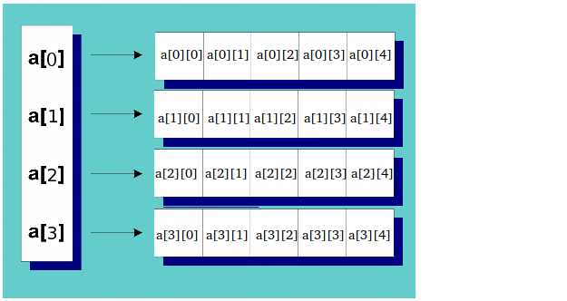

Allocating for a 2D array in C++
int** ary = new int*[rowCount];
for(int i = 0; i < rowCount; ++i)
{
ary[i] = new int[colCount];
}
To delete
for(i =0; i< rowCount; i++)
{
delete [] ary[i];
}
delete [] ary;

Slide 22
Initializing Values in C++11
In C++ 11, putting empty { } after a variable definition indicates that the variable should be initialized to its default value
int x {}; this tells the complier to initialize x to the standard default value
This will also work with a pointer
int *x {}
In C we initialize a pointer to either 0 or NULL
The problem with this is this indicated the address is 0 (NULL translates to 0)
C++ 11 also has the key word nullptr to indicate that a pointer variable does not contain a valid memory location
nullptr translates to “no valid address”
null.cpp nullptr.cpp

Slide 23
Smart Pointer C++11
Objects that work like pointers but have the ability to automatically delete dynamically allocated memory
They can be used to solve the following problems in a large software project
dangling pointers – pointers whose memory is deleted while the pointer is still being used
memory leaks – allocated memory that is no longer needed but is not deleted
double-deletion – two different pointers de-allocating the same memory

Slide 24
Smart Pointer C++11
Smart pointers are objects that work like pointers.
Unlike regular (raw) pointers, smart pointers can automatically delete dynamic memory that is no longer being used.
There are three types of smart pointers:
unique pointers(unique_ptr)
shared pointers(shared_ptr)
weak pointers(weak_ptr) This will not be covered in this class

Slide 25
Unique Pointer C++11
#include <memory>
A unique pointer points to a dynamically allocated object that has a single owner
Ex. unique_ptr<int> uptr1(new int);
This points to an int. When this pointers goes out of scope the the unique_ptr class will delete the memory associated with this pointer.
Another ex. unique_ptr<int> uptr2;
uptr2 = unique_ptr<int> (new int);

Slide 26
Unique Pointer C++11
To avoid memory leaks, objects that are managed by smart pointers should have no other references to them.
Should NOT do the following:
int *p = new int;
unique_ptr<int> uptr(p);
Smart pointer do not support pointer arithmetic ( uptr++, uptr = uptr +2)
Does support dereferencing: (* and ->)
Can not initialize a unique_ptr with the value of another unique_ptr object
Unique_ptr<int> uptr1(new int);
Unique_ptr<int> uptr2 = uptr1; not allowed.

Slide 27
Unique Pointer C++11 move()
C++ provides a the move() function that transfers ownership from one unique pointer to another
unique_ptr <int> uptr1(new int);
*uptr1 = 15;
unique_ptr<int> uptr2(new int);
uptr2 = move(uptr1); //what happens: uptr2 is deallocated and then uptr1 gives ownership of the memory to uptr2.
uptr1 = nullptr;
cout << *uptr2 << endl; // this will print 15

Slide 28
Clearing a unique pointer
Unique pointers deallocate the memory for their objects when they go out of scope.
To manually deallocate memory, use:
uptr = nullptr; or uptr.reset();
C++14 has made additional changes to unique pointers. We will not discuss this at this time.
unique_ptr.cpp

Slide 29
unique pointer and arrays
Use array notation when using an unique pointer to allocate memory for an array
Unique_ptr<int[]> uptr(new int[5]);
Doing so ensures that the proper deallocation(delete[] instead of delete) will be used.

Slide 30
Shared pointers
A shared pointer points to a dynamically allocated object that may have multiple owners.
A control block manages the reference count of the number of shared owners and also possibly the raw pointer if one exists.
sharedTest.cpp

Slide 31
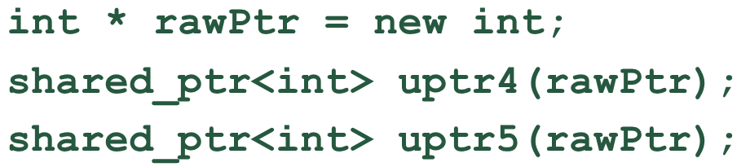
Shared pointers
Be careful that all references to a dynamic object are tracked in the same control block
In the code below:
Two control blocks are created. This can cause a dangling pointer.
Cannot create an array of shared pointers.

